Slide 1


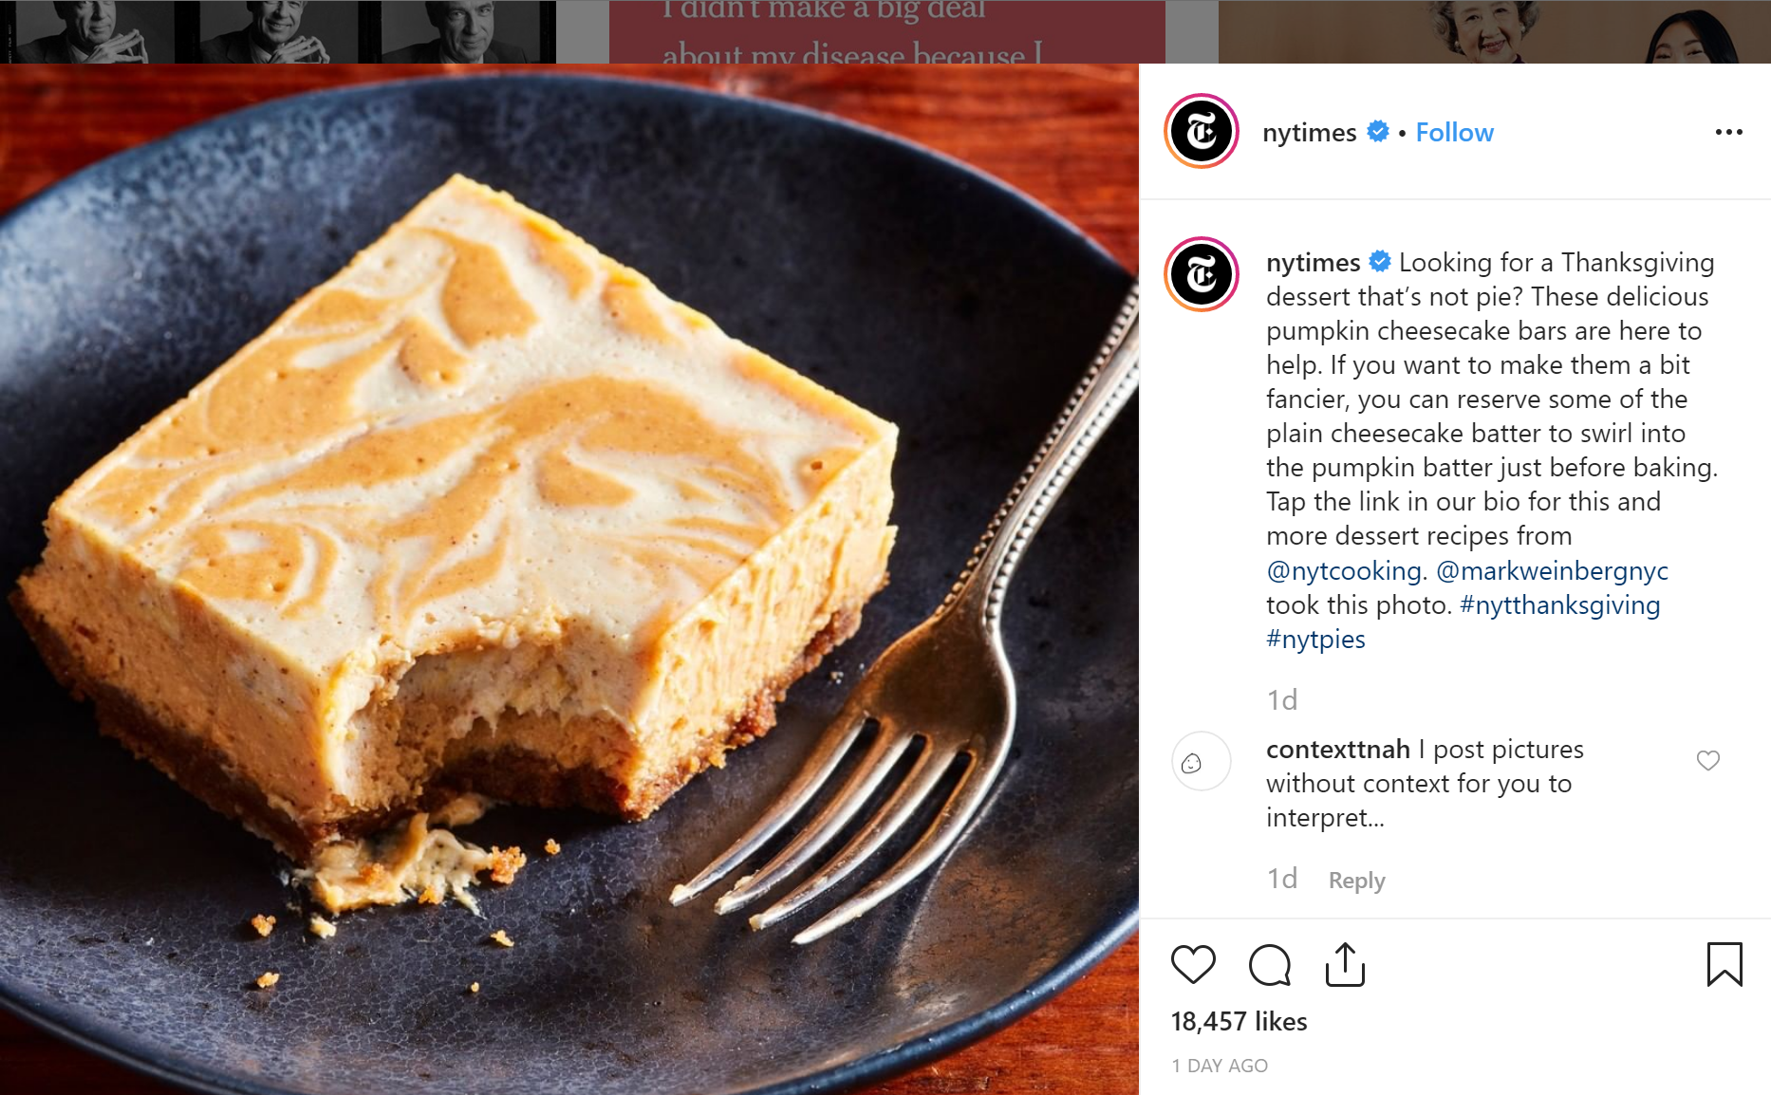

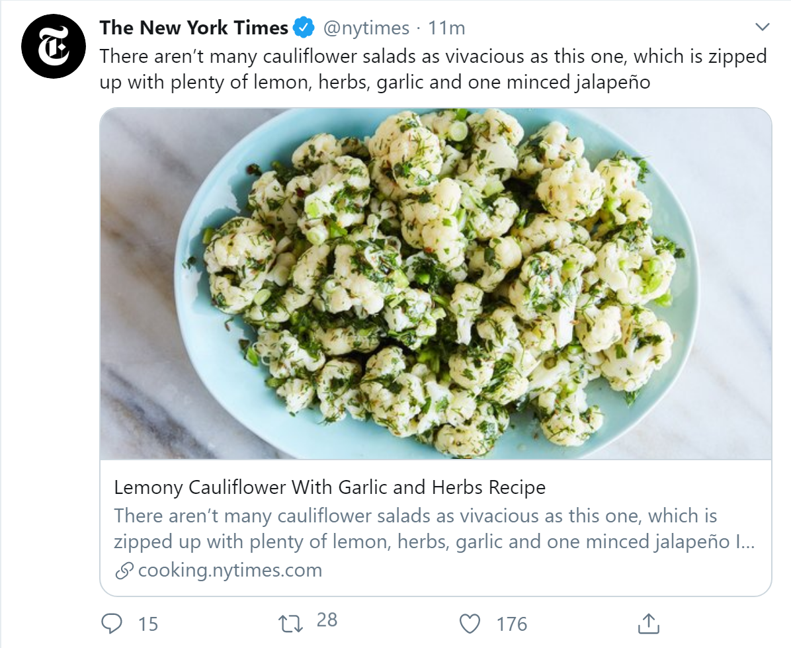

One Feed
Social Media Simplified
OneFeed takes all social media feeds of the supported brands and puts them together in one feed
Coder: Maverick Jones
https://github.com/ksu-is/OneFeed

